Slide 1

Mini Project DE
Data Case Study: Northwind Traders Database
by Adrian Maulana Muhammad

Slide 2
Table of Contents
1
2
3
Business & Data
Understanding
Analysis
Objectives
Data Processing Flowchart
4
5
6
Data
Preprocessing
Data
Analysis
Summaries

Slide 3
Business & Data Understanding
Northwind Traders

Slide 4
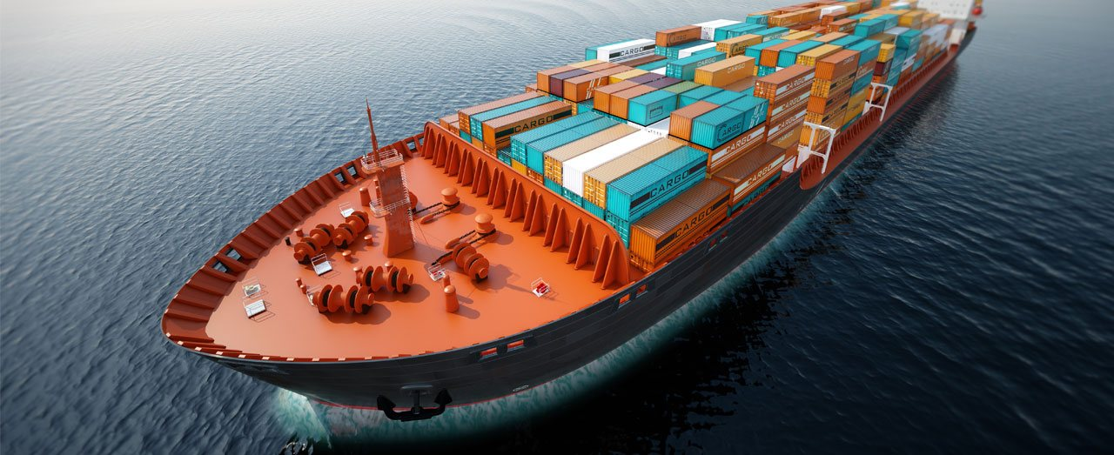
Northwind Traders
Northwind Traders is a fictional company that operates as a wholesale supplier of food and non-food products. The database represents a typical business operating in the retail industry, which includes a wide range of products, customers, orders, and employees.

Slide 5
Analysis Objectives
Product Analysis|Customer Analysis|Shipper Analysis

Slide 6
Product Analysis
Analysis of Product Sales by Category
Use join to combine the data from the "Products", "OrderDetails" and "Categories" tables.
Use aggregation to group the joined data by category and calculate the sum of quantity sold and total revenue for each category.
Use filtering to display only categories that have sold units above the average.
Analysis of The Best-Selling Products
Join the Orders and Order Details tables to retrieve order details information.
Filter the order details information to retrieve only the needed information.
Group the data by product ID and aggregate the data to find the total quantity of each product sold.
Sort the data in descending order to find the best-selling product.
Join the Products table to retrieve the product name.
Select the product name and total quantity to display the best-selling product information.

Slide 7
Customer Analysis
Analysis of Customer Spending by Country
Use join to combine the data from the "Customers" and "Orders Details" tables.
Use aggregation to group the joined data by country and calculate the sum of total revenue for each country.
Use filtering to display only countries where customer spending is above the average.
Analysis of The Most Frequent Customers by Number of Orders
Use CTE to create a subquery that counts the number of orders per customer.
Use filtering to display only customers who have placed more than average orders.
Use sorting to order the data by the number of orders per customer and display the top 10 most frequent customers.

Slide 8
Shipper Analysis
Analysis of Average Delivery Time per Shipper
Use join to combine the data from the "Orders" and "Shippers" tables.
Use condition to calculate the difference between the "ShippedDate" and "OrderDate" columns.
Use aggregation to group the joined data by shipper and calculate the average delivery time for each shipper.
Analysis of The Busiest Shippers
Use join to combine the data from the "Orders" and "Shippers" tables.
Use aggregation to count the number of orders shipped by each shipper.
Use sorting to order the data by the number of shipped orders and display the top 10 busiest shippers.

Slide 9
Data Processing Flowchart
Product Analysis Flowchart|Customer Analysis Flowchart|Shipper Analysis Flowchart

Slide 10
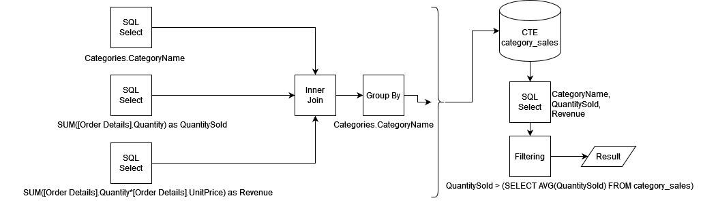
Product Analysis Flowchart
Flowchart of Analysis of Product Sales by Category

Slide 11
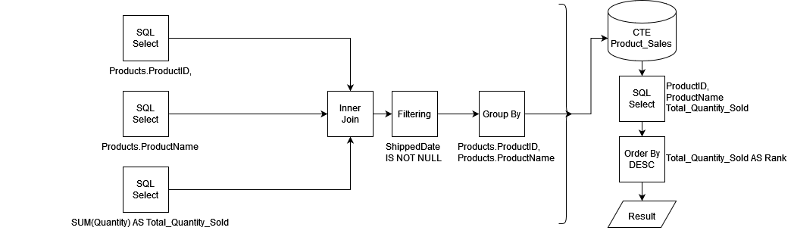
Product Analysis Flowchart
Flowchart of Analysis of The Best-Selling Products

Slide 12
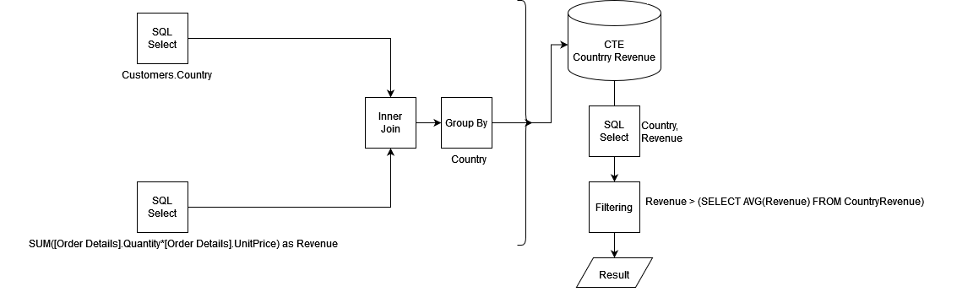
Customer Analysis Flowchart
Flowchart of Analysis of Customer Spending by Country

Slide 13
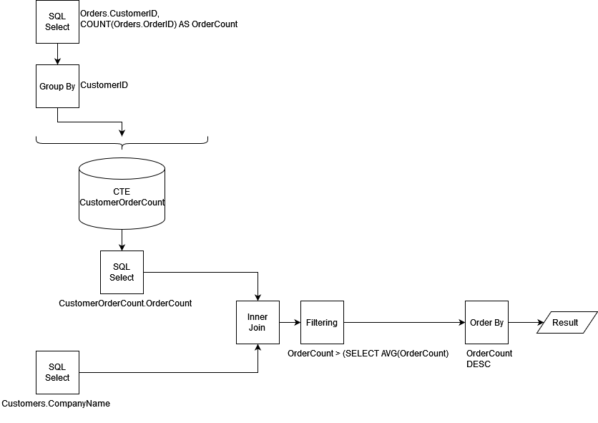
Customer Analysis Flowchart
Flowchart of Analysis of The Most Frequent Customers by Number of Orders

Slide 14
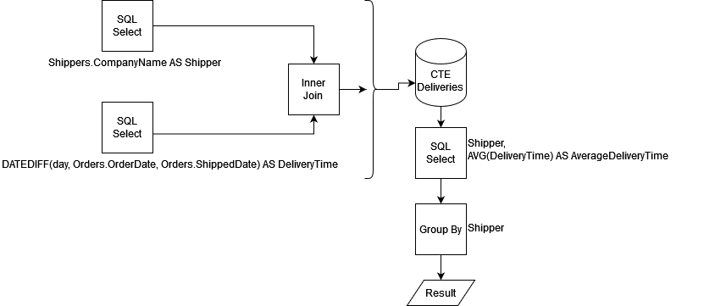
Shipper Analysis Flowchart
Flowchart of Analysis of Average Delivery Time per Shipper

Slide 15
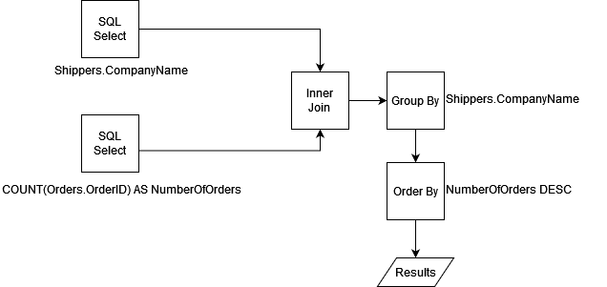
Shipper Analysis Flowchart
Flowchart of Analysis of The Busiest Shippers

Slide 16
Data Processing
Product Analysis Queries|Customer Analysis Queries|Shipper Analysis Queries

Slide 17
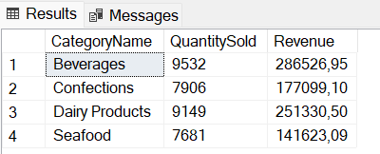
Product Analysis Queries
Query of Analysis of Product Sales by Category
WITH category_sales AS (
SELECT
Categories.CategoryName,
SUM([Order Details].Quantity) as QuantitySold,
SUM([Order Details].Quantity*[Order Details].UnitPrice) as Revenue
FROM
Products
JOIN
[Order Details] ON Products.ProductID = [Order Details].ProductID
JOIN
Categories ON Products.CategoryID = Categories.CategoryID
GROUP BY
Categories.CategoryName
)
SELECT
CategoryName,
QuantitySold,
Revenue
FROM
category_sales
WHERE
QuantitySold > (SELECT AVG(QuantitySold) FROM category_sales)

Slide 18
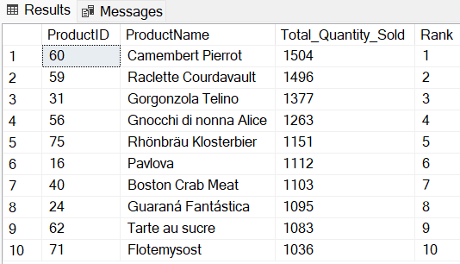
Product Analysis Queries
Query of Analysis of The Best-Selling Products
WITH Product_Sales AS (
SELECT
Products.ProductID, Products.ProductName,
SUM(Quantity) AS Total_Quantity_Sold
FROM
Orders
INNER JOIN
[Order Details] ON Orders.OrderID = [Order Details].OrderID
INNER JOIN
Products ON [Order Details].ProductID = Products.ProductID
WHERE
ShippedDate IS NOT NULL
GROUP BY
Products.ProductID, Products.ProductName
)
SELECT TOP 10
ProductID,
ProductName,
Total_Quantity_Sold,
ROW_NUMBER() OVER (ORDER BY Total_Quantity_Sold DESC) AS Rank
FROM
Product_Sales

Slide 19
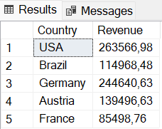
Customer Analysis Queries
Query of Analysis of Customer Spending by Country
WITH CountryRevenue AS(
SELECT
Customers.Country,
SUM([Order Details].Quantity*[Order Details].UnitPrice) as Revenue
FROM Customers
JOIN Orders ON Customers.CustomerID = Orders.CustomerID
JOIN [Order Details] ON [Order Details].OrderID = Orders.OrderID
GROUP BY Country)
SELECT * FROM CountryRevenue
WHERE Revenue > (SELECT AVG(Revenue) FROM CountryRevenue)

Slide 20
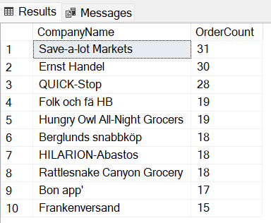
Customer Analysis Queries
Query of Analysis of The Most Frequent Customers by Number of Orders
WITH CustomerOrderCount AS (
SELECT
CustomerID,
COUNT(OrderID) AS OrderCount
FROM Orders
GROUP BY CustomerID
)
SELECT TOP 10
Customers.CompanyName,
CustomerOrderCount.OrderCount
FROM Customers
JOIN CustomerOrderCount ON Customers.CustomerID = CustomerOrderCount.CustomerID
WHERE
CustomerOrderCount.OrderCount > (SELECT AVG(OrderCount) FROM CustomerOrderCount)
ORDER BY
CustomerOrderCount.OrderCount DESC

Slide 21
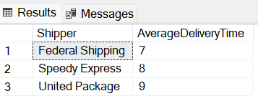
Shipper Analysis Queries
Query of Analysis of Average Delivery Time per Shipper
WITH deliveries AS (
SELECT
Shippers.CompanyName AS Shipper,
DATEDIFF(day, Orders.OrderDate, Orders.ShippedDate) AS DeliveryTime
FROM Orders
JOIN Shippers ON Orders.ShipVia = Shippers.ShipperID
)
SELECT
Shipper,
AVG(DeliveryTime) AS AverageDeliveryTime
FROM deliveries
GROUP BY Shipper

Slide 22
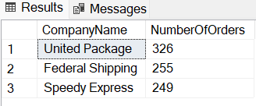
Shipper Analysis Queries
Query of Analysis of The Busiest Shippers
SELECT
Shippers.CompanyName,
COUNT(Orders.OrderID) AS NumberOfOrders
FROM
Orders
INNER JOIN Shippers
ON Orders.ShipVia = Shippers.ShipperID
GROUP BY
Shippers.CompanyName
ORDER BY
NumberOfOrders DESC

Slide 23
Data Analysis
Product Analysis|Customer Analysis|Shipper Analysis

Slide 24
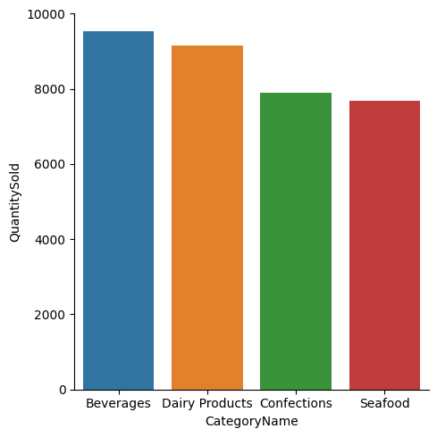
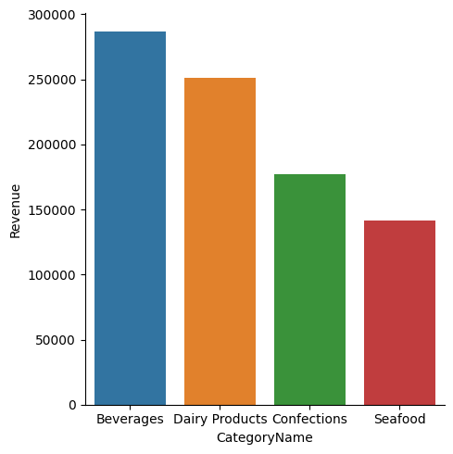
What category of items sold the most?
Based on the data visualization shown, it is evident that the product category which generated the highest revenue and sold the most units is Beverages, while the category with the lowest revenue is Seafood. The findings are aligned with the analysis of the Northwind database and provide valuable insights into the market performance of different product categories.

Slide 25
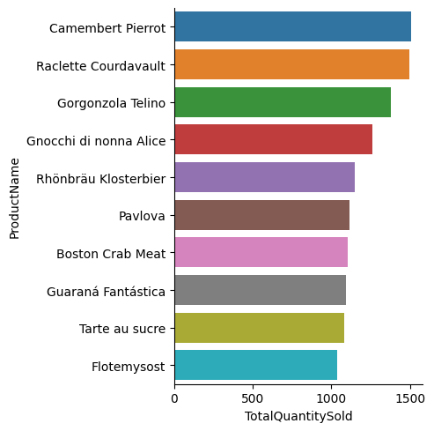
What is the best-selling product?
Based on the data visualization displayed alongside, it is evident that the most highly sold product is Camembert Pierrot. Further analysis of the sales figures for this product indicates that it has consistently been one of the top-performing products within the Northwind inventory.

Slide 26
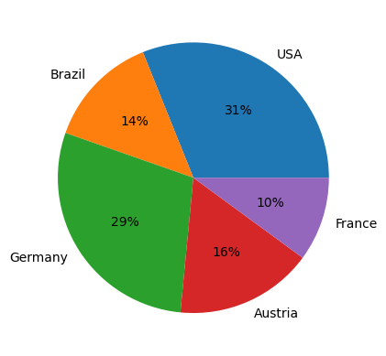
From which country do the customers originate?
Based on the visualization data displayed, it is evident that most customers are located in the United States, while the least amount of customers is from France. This can provide valuable insights into the geographical distribution of the customer base and can be used to inform future business strategies and marketing efforts.

Slide 27
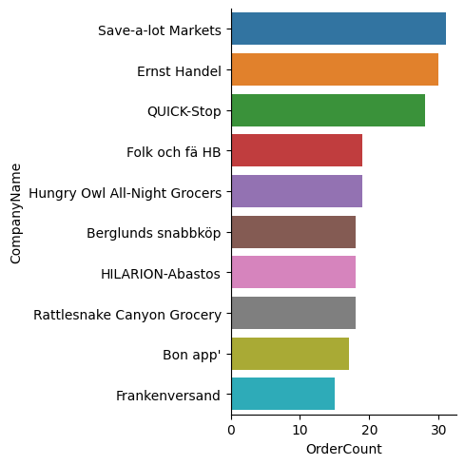
Which company places the most orders?
Based on the visualization data shown alongside, it can be seen that the company that places the most orders is Save-a-lot Markets, and the company that places the least orders is Frankenversand. The insights gleaned from this analysis are indicative of the purchasing patterns of different companies and could provide valuable information for businesses looking to optimize their sales and marketing strategies.

Slide 28
Summaries
Based on the above data analysis, several conclusions can be drawn.

Slide 29
Based on the above data analysis, the following conclusions can be drawn
From the above facts, it can be concluded that the Beverages product category is the most profitable and highly sold product category in the Northwind database. This information can be used to inform product development and inventory management strategies, by prioritizing the production of similar products or expanding the Beverages category.
Furthermore, the high sales performance of Camembert Pierrot highlights the potential for similar products to perform well in the market. This could be used to inform product development and marketing efforts for similar products.
The majority of customers are located in the United States, which suggests that there may be potential for further growth in this market. Marketing and sales efforts could be focused on this region to target potential customers and increase sales.
Save-a-lot Markets places the most orders, which suggests that they may be a valuable target for business-to-business sales and marketing efforts. On the other hand, the low number of orders placed by Frankenversand highlights the potential for further growth in this market and the opportunity to target this company for increased sales.

Slide 30
Thank You
Email
adrian.m.muhammad@gmail.com
Phone
+6285233791448
Website
github.com/adrn-mm/DSLS_Mini-Project-DE_Adrian-Maulana-Muhammad
Linkedin
linkedin.com/in/adrn-mm/

